Slide 1
AI Project
CSL7540
Create a search function to search in a NAS space for the best performing CNN architecture on fashion-mnist.
Presented by:
Himanshi(M21CS006)
Shruti Sureshan(M21CS015)
Shubham Singh(M21CS016)

Slide 2
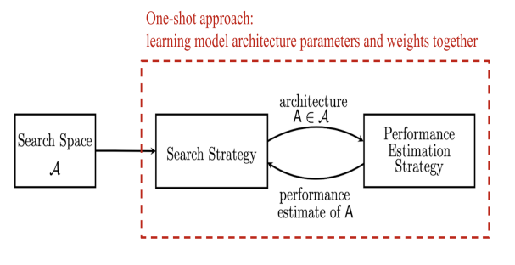
Methodology Followed:

Slide 3
Search Space
p_Cost = (para - p_para) + p_acc
n_Cost = (para - n_para) + n_acc
Select genome string
Previous CNN model
Next CNN model
Evaluate the accuracy and parameters required
Estimate Cost
Estimate Cost
Compare Cost
Examine models with respect to the Goal.

Slide 4
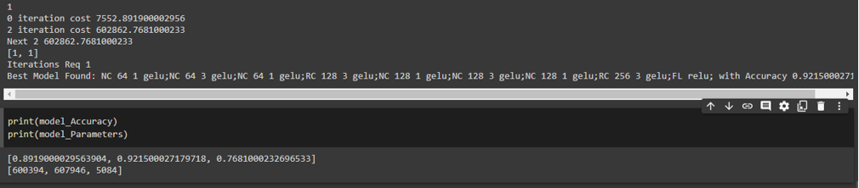
Result
1.

Slide 5
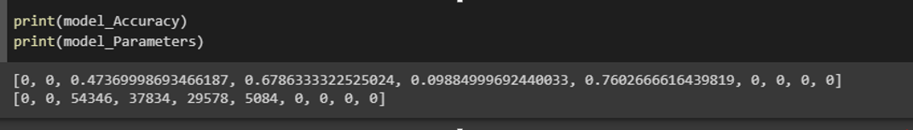
2.

Slide 6
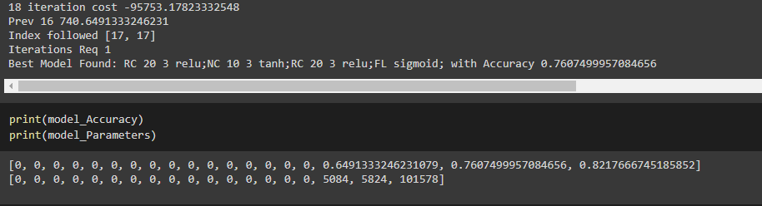
3.

Slide 7
ThankYou!

